Slide 1
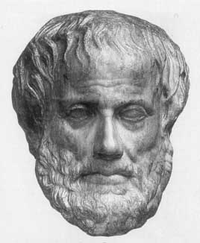
Lecture 3:
Search in Problem Solving
Junfeng Yao
Xiamen University
Slides used in the classroom only

Slide 2
Lecture overview
Artificial Intelligence
3. Search in Problem Solving

Slide 3
Solving Problems by Searching
Goal-based agents can succeed by considering future actions and the desirability of their outcomes.
One kind of goal-based agent called a problem-solving agent.
Problem-solving agents decide what to do by finding sequences of actions that lead to desirable states.
Several general-purpose search algorithms can be used to solve the problems just described.

Slide 4
Examples of Search Problems
Chess: search through set of possible moves
  Looking for one which will best improve position
Route planning: search through set of paths
  Looking for one which will minimize distance
Theorem proving:
  Search through sets of reasoning steps
    Looking for a reasoning progression which proves theorem
Machine learning:
  Search through a set of concepts
    Looking for a concept which achieves target categorisation

Slide 5
What is Learning?
Herbert Simon: “Learning is any process by which a system improves performance from experience.”
What is the task?
  Classification
  Problem solving / planning / control

Slide 6
Search Terminology
States
  “Places” where the search can visit
Search space
  The set of possible states
Search path
  The states which the search agent actually visits
Solution
  A state with a particular property
    Which solves the problem (achieves the task) at hand
  May be more than one solution to a problem
Strategy
  How to choose the next step in the path at any given stage

Slide 7
Search Terminology …
Goal
Goal formulation
Problem formulation: is the process of deciding what actions and states to consider, given a goal.
Search

Slide 8
Well-defined problems and solutions
A problem can be defined formally by four components: (page 62)
  Initial state
  Actions
  Goal test
  Path cost

Slide 9
Specifying a Search Problem
Three important considerations
1. Initial state
  So the agent can keep track of the state it is visiting
2. Operators
  Function taking one state to another
  Specify how the agent can move around search space
  So, strategy boils down to choosing states & operators
3. Goal test
  How the agent knows if the search has succeeded

Slide 10
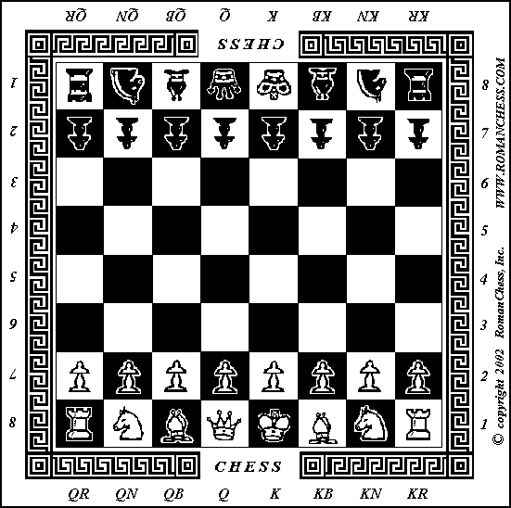
Example 1 - Chess
Chess
Initial state
  As in picture
Operators
  Moving pieces
Goal test
  Checkmate
    king cannot move
    without being taken

Slide 11
Example 2 – Route Planning
Initial state
  City the journey starts in
Operators
  Driving from city to city
Goal test
  If current location is
    Destination city
Liverpool
Leeds
Nottingham
Manchester
Birmingham
London

Slide 12
Two types of Search Algorithms
Uninformed search algorithms: they are given no information about the problem other than its definition
Informed search algorithms: the algorithms have some idea of where to look for solutions.

Slide 13
General Search Considerations
1. Path or Artefact
Is it the route or the destination you are interested in?
Route planning
  Already know the destination, so must record the route (path)
Solving anagram puzzle
  Doesn’t matter how you found the word in the anagram
  Only the word itself (artefact) is important
Machine learning
  Usually only the concept (artefact) is important
Automated reasoning
  The proof is the “path” of logical reasoning

Slide 14
General Search Considerations
2. Completeness
Think about the density of solutions in space
Searches guaranteed to find all solutions
  Are called complete searches
Particular tasks may require one/some/all solutions
  E.g., how many different ways to get from A to B?
Pruning versus exhaustive searches
  Exhaustive searches try all possibilities
  If only one solution required, can employ pruning
    Rule out certain operators on certain states
  If all solutions are required, we have to be careful with pruning
    Check no solutions can be ruled out

Slide 15
General Search Considerations
3. Time and Space Tradeoffs
With many computing projects, we worry about:
  Speed versus memory
Fast programs can be written
  But they use up too much memory
Memory efficient programs can be written
  But they are slow
We consider various search strategies
  In terms of their memory/speed tradeoffs

Slide 16
General Search Considerations
4. Soundness
Unsound search strategies:
  Find solutions to problems with no solutions
Particularly important in automated reasoning
  Prove a theorem which is actually false
Have to check the soundness of search
Not a problem
  If the only tasks you give it always have solutions
Another unsound type of search
  Produces incorrect solutions to problems
    More worrying, probably problem with the goal check

Slide 17
General Search Considerations
5. Additional Information
Can you give the agent additional info?
  In addition to initial state, operators and goal test
Uninformed search strategies
  Use no additional information
Heuristic search strategies
  Take advantage of various values
    To drive the search path

Slide 18
Measuring problem-solving performance
Completeness
Optimality
Time complexity
Space complexity

Slide 19
Graph and Agenda Analogies
Graph Analogy
  States are nodes in graph, operators are edges
  Choices define search strategy
    Which node to “expand” and which edge to “go down”
Agenda Analogy
  Pairs (State,Operator) are put on to an agenda
  Top of the agenda is carried out
    Operator is used to generate new state from given one
  Agenda ordering defines search strategy
    Where to put new pairs when a new state is found

Slide 20
Example Problem
Genetics Professor
  Wanting to name her new baby boy
  Using only the letters D,N & A
Search by writing down possibilities (states)
  D,DN,DNNA,NA,AND,DNAN, etc.
  Operators: add letters on to the end of already known states
  Initial state is an empty string
Goal test
  Look up state in a book of boys names
  Good solution: DAN

Slide 21
Uninformed Search Strategies
1. Breadth First Search
Every time a new state, S, is reached
  Agenda items put on the bottom of the agenda
E.g., New state “NA” reached
  (“NA”,add “D”), (“NA”,add “N”),(“NA”,add “A”)
  These agenda items added to bottom of agenda
  Get carried out later (possibly much later)
Graph analogy:
  Each node on a level is fully expanded
  Before the next level is looked at

Slide 22
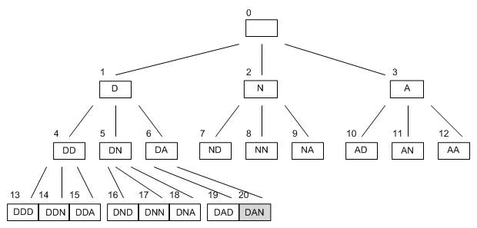
Breadth First Search
Branching rate
  Average number of edges coming from a node
Uniform Search
  Every node has same number of branches (as here)

Slide 23
Uninformed Search Strategies
2. Depth First Search
Same as breadth first search
  But the agenda items are put at the top of agenda
Graph analogy:
  Each new node encountered is expanded first
Problem with this:
  Search can go on indefinitely down one path
  D, DD, DDD, DDDD, DDDDD, …
Solution:
  Impose a depth limit on the search
  Sometimes the limit is not required
    Branches end naturally (i.e. cannot be expanded)

Slide 24
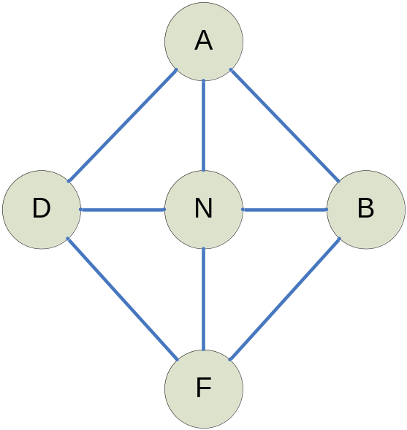
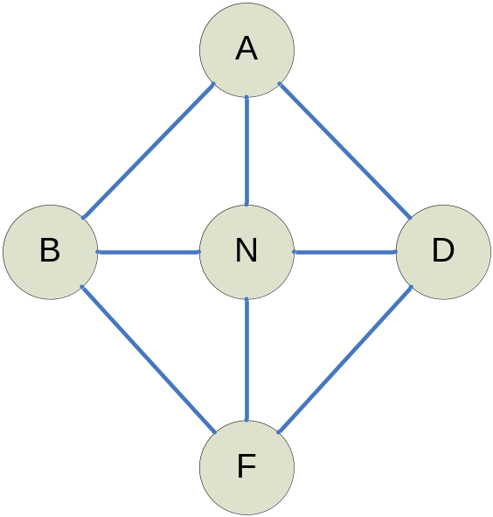
Examples for Depth First Search
What is the search sequence?

Slide 25
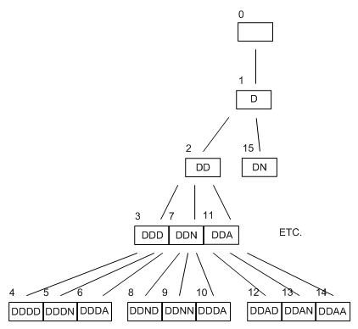
Depth First Search #1
Depth limit of 3 could (should?) be imposed

Slide 26
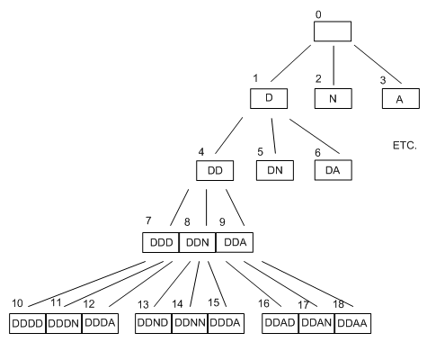
Depth First Search #2 (R&N)

Slide 27
Depth v. Breadth First Search
Suppose we have a search with branching rate b
Breadth first
  Complete (guaranteed to find solution)
  Requires a lot of memory
    Needs to remember up to b^{d-1} states to search down to depth d
Depth first
  Not complete because of the depth limit
  But is good on memory
    Only needs to remember up to b*d states to search to depth d

Slide 28
Uniform-cost Search
Uniform-cost search is similar to breadth-first search but expands the node with the lowest path cost g(n).

Slide 29
Iterative Deepening Depth-First Search (IDS)
If you are about to start searching a chess position, how deep should you search it? It is difficult to predict in advance how long a search will take, since the time it takes to complete a search of depth D is dependent upon factors that might not be obvious.
In a complex middle game position, you might search not very deeply at all, while in an ending you might search significantly deeper, and in some king + pawn endings you might be able to search a hundred plies.
An idea is to search to depth one. If this search completes in less than the amount of time allocated, search again to depth two. And then to depth three. And so on, until you run out of time.

Slide 30
Iterative Deepening Search (IDS) …
This all but guarantees pretty good time usage. If you are able to perform a deep search quickly, you'll continue along and search even deeper the next time, and perhaps you'll finish that. If the position is more complicated than you expected, you won't finish many plies of search, but you will have at least some legal move to play, since it's almost impossible to not finish a 1-ply search.
This idea is called iterative deepening, because what happens is you iterate the search, going one ply deeper each time (there is nothing magic about going one ply deeper, for instance you could try two, but one works very well).

Slide 31
Formal definition of IDS
Be familiar with both breadth-first and depth-first searching algorithms before attempting this iterative deepening.
Iterative deepening is a graph search algorithm. It combines properties of depth first searching and breadth first searching. The basic idea is to implement a depth first search up to the Nth level. N should start at either 0 or 1 and be incremented after each search up to N is complete. This searching technique is complete and is guaranteed to return the desired node.
Starting with N=1 the nodes in a tree are searched as far as level N, N is then incremented (unless the desired node has been found) and the next level is searched. So with N=1 only three (if a binary tree is used) nodes will be searched. Assuming a balanced tree and more than 5 nodes, if N=2 the first three will be searched and then the immediate children of those (to a maximum depth of 2) this continues until the whole tree has been searched or time runs out.

Slide 32
Iterative Deepening Search (IDS)
Is analogous to breadth-first search in that it explores a complete layer of new nodes at each iteration before going on to the next layer.
  Complete and memory efficient
  But it is slower than either search strategies
Idea: do repeated depth first searches(DFS)
  Increasing the depth limit by one every time (Figure 3.15 page 79)
i.e., depth first to depth 1, depth first to depth 2, etc.
  Completely re-do the previous search each time
Sounds like a terrible idea
  But not as time consuming as you might think
    Most of effort in expanding last line of the tree in DFS
  E.g. to depth five, branching rate of 10
  111,111 states explored in depth first, 123,456 in IDS
    Repetition of only 11%

Slide 33
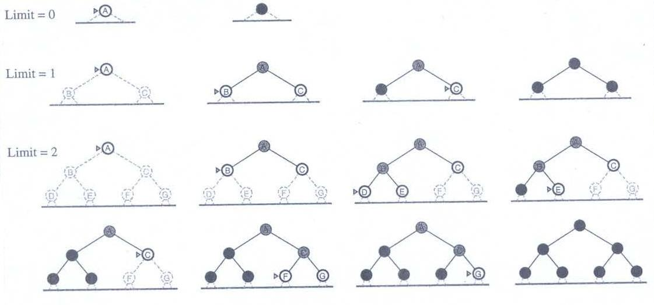
IDS …
Figure 3.15 Four iterations of iterative deepening search on a binary tree

Slide 34
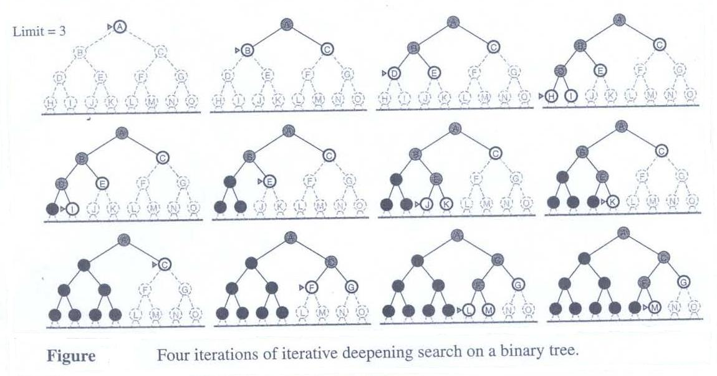
IDS …
Figure 3.15 cont.

Slide 35
Bidirectional Search
If you know the solution state
  Looking for the path from initial to the solution state
  Then you can also work backwards from the solution
Advantages:
  Only need to go to half depth
Difficulties
  Do you really know solution? Unique?
  Cannot reverse operators
  Record all paths to check they meet
    Memory intensive
Liverpool
Leeds
Nottingham
Manchester
Birmingham
Peterborough
London

Slide 36
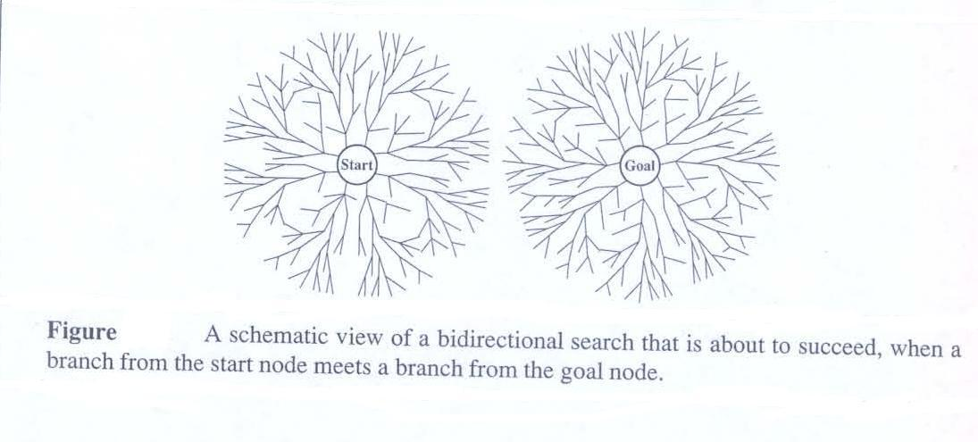
Bidirectional Search …
Figure 3.16 A schematic view of a bidirectional search that is about to succeed, when a branch from the start node meets a branch from the goal node.

Slide 37
Bidirectional Search …
The idea behind bidirectional search is to run two simultaneous searches – one forward from the initial state and the other backward from the goal, stopping when the two searches meet in the middle.
The motivation is that b^{d/2} ⁺ b^{d/2} is much less than b^{d}. What is the strategy in terms of algorithm design?

Slide 38
Using Values in Search
1. Action and Path Costs
Want to use values in our search
  So the agent can guide the search intelligently
Action cost
  Particular value associated with an action
Example
  Distance in route planning
  Power consumption in circuit board construction
Path cost
  Sum of all the action costs in the path
  If action cost = 1 (always), then path cost = path length

Slide 39
Informed (Heuristic) Search and Exploration

Slide 40
What are Heuristics?
Definition 1: Decisions made by ‘educated guesswork’ for problem solving in a situation of uncertainty.
Definition 2: A problem-solving technique in which the most appropriate solution is selected using rules.
Definition 3: Heuristics are rules of thumb people follow in order to make judgments quickly and efficiently.
Definition 4: An algorithm that quickly produces good but not necessarily optimal solutions is called a heuristic.

Slide 41
Using Values in Search
Heuristic Functions
Estimate path cost
  From a given state to the solution
  Write h(n) for heuristic value for n
  h(goal state) must equal zero
Use this information
  To choose next node to expand
  (Heuristic searches)
Derive them using
  (i) maths (ii) introspection
  (iii) inspection (iv) programs (e.g., ABSOLVE)
Example: straight line distance
  As the crow flies in route planning
Liverpool
Leeds
135
Nottingham
155
75
Peterborough
120
London

Slide 42
Heuristic Searches
Heuristics are very important in AI
  Rules of thumb, particularly useful for search
  Different from heuristic measures (calculations)
  In search, we can use the values in heuristics
    In our case, how we use path cost and heuristic measures
Rules of thumb dictate:
  Agenda analogy: where to place new pairs (S,O)
  Graph analogy: which node to expand at a given time
    And how to expand it
Optimality
  Often interested in solutions with the least path cost

Slide 43
Heuristic Searches
1. Uniform Path Cost
Breadth first search
  Guaranteed to find the shortest path to a solution
    Not necessarily the least costly path, though
Uniform path cost search
  Choose to expand node with the least path cost
  (ignore heuristic measures)
Guaranteed to find a solution with least cost
  If we know that path cost increases with path length
This method is optimal and complete
  But can be very slow

Slide 44
Heuristic Searches
2. Greedy Search
A Type of Best First Search
  “Greedy”: always take the biggest bite
This time, ignore the path cost
Expand node with smallest heuristic measure
  Hence estimated cost to solution is the smallest
Problems
  Blind alley effect: early estimates very misleading
    One solution: delay the usage of greedy search
  Not guaranteed to find optimal solution
    Remember we are estimating the path cost to solution

Slide 45
Heuristic Searches
3. A* Search
Want to combine uniform path cost and greedy searches
  To get complete, optimal, fast search strategies
Suppose we have a given (found) state n
  Path cost is g(n) and heuristic function is h(n)
  Use f(n) = g(n) + h(n) to measure state n
  Choose n which scores the lowest
Basically, just summing path cost and heuristic
Can prove that A* is complete and optimal
  But only if h(n) is admissible,
    i.e. It underestimates the true path cost to solution from n
  See Russell and Norvig for proof
Any graph search algorithm is said to be admissible if it always returns an optimal solution, that is the one with the lowest cost, if a solution exists at all.

Slide 46
A* Search
A* (pronounced "A star") is a best-first, graph search algorithm that finds the least-cost path from a given initial node to one goal node (out of one or more possible goals).
It uses a distance-plus-cost heuristic function (usually denoted f(x)) to determine the order in which the search visits nodes in the tree. The distance-plus-cost heuristic is a sum of two functions: the path-cost function (usually denoted g(x), which may or may not be a heuristic) and an admissible "heuristic estimate" of the distance to the goal (usually denoted h(x)). The path-cost function g(x) is the cost from the starting node to the current node.

Slide 47
A* Search
Since the h(x) part of the f(x) function must be an admissible heuristic, it must underestimate the distance to the goal. Thus for an application like routing, h(x) might represent the straight-line distance to the goal, since that is physically the smallest possible distance between any two points (or nodes for that matter).
The algorithm was first described in 1968 by Peter Hart, Nils Nilsson, and Bertram Raphael. In their paper, it was called algorithm A. Since using this algorithm yields optimal behavior for a given heuristic, it has been called A*.
This algorithm has been generalized into a bidirectional heuristic search algorithm; see bidirectional

Slide 48
A* Algorithm
What sets A* apart from a greedy best-first search is that it also takes the distance already traveled into account (the g(x) part of the heuristic is the cost from the start, and not simply the local cost from the previously expanded node).
Starting with a given node, the algorithm expands the node with the lowest f(x) value—the node that has the highest cost-per-benefit. A* maintains a set of partial solutions—unexpanded leaf nodes of expanded nodes—stored in a priority queue. The priority assigned to a path x is determined by the function f(x) = g(x) + h(x). The function continues until a goal has a lower f(x) value than any node in the queue (or until the tree is fully traversed).

Slide 49
A* Algorithm
function A*(start,goal)
  var closed := ''the empty set''
  var q := make_queue(path(start))
  while q ''is not empty''
    var p := remove_first(q)
    var x := ''the last node of p''
    if x in closed
      continue
    if x = goal
      return p
    ''add x to closed''
    For each y in successors(x)
      enqueue(q, p, y)
    return failure

Slide 50
Example: Route Finding
First states to try:
  Birmingham, Peterborough
f(n) = distance from London + crow flies distance from state
  i.e., solid + dotted line distances
  f(Peterborough) = 120 + 155 = 275
  f(Birmingham) = 130 + 150 = 280
Hence expand Peterborough
  Returns later to Birmingham
    It becomes best state
      Must go through Leeds from Notts
Liverpool
Leeds
135
Nottingham
150
155
Birmingham
Peterborough
130
120
London

Slide 51
A* for 8 puzzle: An example
Let's look at the 8 puzzle in more detail. This is a simple sliding tile puzzle on a 3*3 grid where one tile is missing and you can move the other tiles into the gap until you get the puzzle into the goal position.
See figure 1.

Slide 52
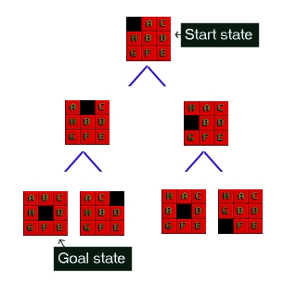
8 puzzle …
.
Figure 1: The 8-Puzzle state space for a very simple example

Slide 53
8 puzzle …
There are 362,880 different states that the puzzle can be in, and to find a solution the search has to find a route through them. (why?)
From most positions of the search the number of edges (that's the blue lines) is two. That means that the number of nodes you have in each level of the search is 2^{d} where d is the depth. If the number of steps to solve a particular state is 18, then that is 262,144 nodes just at that level.

Slide 54
8 puzzle …
The rules that you can apply to the puzzle are also simple. If there is a blank tile above, below, to the left or to the right of a given tile, then you can move that tile into the space.
To solve the puzzle you need to find the path from the start state, through the graph down to the goal state.

Slide 55
Implementing A*
What we need to do is start with the goal state and then generate the graph downwards from there.
Let's take the 8-puzzle in figure 1. We ask how many moves can we make from the start state? The answer is 2, there are two directions we can move the blank tile, and so our graph expands.
If we were just to continue blindly generating successors to each node, we could potentially fill the computer's memory before we found the goal node. Obviously we need to remember the best nodes and search those first. We also need to remember the nodes that we have expanded already, so that we don't expand the same state repeatedly.

Slide 56
Implementing A* …
Let's start with the OPEN list. This is where we will remember which nodes we haven't yet expanded. When the algorithm begins the start state is placed on the open list, it is the only state we know about and we have not expanded it. So we will expand the nodes from the start and put those on the OPEN list too.
Now we are done with the start node and we will put that on the CLOSED list. The CLOSED list is a list of nodes that we have expanded.
f = g + h

Slide 57
Implementing A* …
Using the OPEN and CLOSED list lets us be more selective about what we look at next in the search. We want to look at the best nodes first.
We will give each node a score on how good we think it is. This score should be thought of as the cost of getting from the node to the goal plus the cost of getting to where we are.
Traditionally this has been represented by the letters f, g and h. 'g' is the sum of all the costs it took to get here, 'h' is our heuristic function, the estimate of what it will take to get to the goal. 'f' is the sum of these two. We will store each of these in our nodes.
Using the f, g and h values the A* algorithm will be directed, subject to conditions we will look at further on, towards the goal and will find it in the shortest route possible.

Slide 58
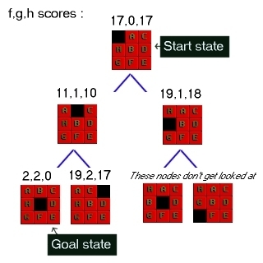
Implementing A* …
Figure 2 : 8-Puzzle state space showing f, g, h scores

Slide 59
Implementing A* …
First of all look at the g score for each node. This is the cost of what it took to get from the start to that node. So in the picture the center number is g. As you can see it increases by one at each level. In some problems the cost may vary for different state changes. For example in pathfinding there is sometimes a type of terrain that costs more than other types.
Next look at the last number in each triple. This is h, the heuristic score. As I mentioned above I am using a heuristic known as Nilsson's Sequence, which converges quickly to a correct solution in many cases. Here is how you calculate this score for a given 8-puzzle state :

Slide 60
A* for 8-puzzle …
Nilsson's sequence score
A tile in the center scores 1 (since it should be empty)
For each tile not in the center, if the tile clockwise to it is not the one that should be clockwise to it then score 2. Multiply this sequence by three and finally add the total distance you need to move each tile back to its correct position.
Looking at the picture you should satisfy yourself that the h scores are correct according to this algorithm.
Finally look at the digit on the left, the f score. This is the sum of g and h, and by tracking the lowest f down through the state space you are doing what the A* algorithm would be doing during its search.

Slide 61
A* for 8-puzzle …
The language of choice for this kind of algorithm is really Common Lisp or Prolog.
This effectively lets you focus on the algorithm rather than the implementation details such as memory and data structures.

Slide 62
A* Pathfinding
Let’s assume that we have someone who wants to get from point A to point B. Let’s assume that a wall separates the two points.
This is illustrated below, with green being the starting point A, and red being the ending point B, and the blue filled squares being the wall in between.

Slide 63
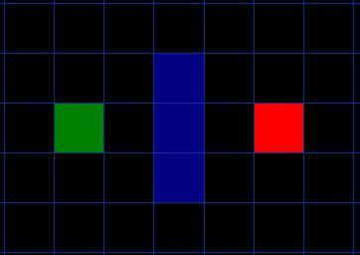
A* Pathfinding …
Figure 3: Green: starting point A, Red: ending point B, and Blue: the wall

Slide 64
A* Pathfinding …
Note:
Our search area is a simple two dimensional array
Each aquare’s status is recorded as walkable or unwalkable
The path is found by figuring out which squares we should take to get from A to B.
Once the path is found, we move from the center of one square to the center of the next until the target is reached.
These center points are called “nodes”

Slide 65
Starting the Search
Conduct a search to find the shortest path; We begin the search by doing the following:
Begin at the starting point A and add it to an “open list” of squares to be considered. The open list is kind of like a shopping list. Right now there is just one item on the list, but we will have more later. It contains squares that might fall along the path you want to take, but maybe not. Basically, this is a list of squares that need to be checked out.

Slide 66
Starting the Search …
2 Look at all the reachable or walkable squares adjacent to the starting point, ignoring squares with walls, water, or other illegal terrain. Add them to the open list, too. For each of these squares, save point A as its “parent square”. This parent square stuff is important when we want to trace our path. It will be explained more later.
3 Drop the starting square A from your open list, and add it to a “closed list” of squares that you don’t need to look at again for now.

Slide 67
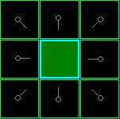
Search Status
The center is outlined in light blue to indicate that the square has been added to the closed list. All of the adjacent squares are now on the open list of squares to be checked, and they are outlined in light green. Each has a gray pointer that points back to its parent, which is the starting square.

Slide 68
What is next?
Next, we choose one of the adjacent squares on the open list and more or less repeat the earlier process.
But which square do we choose? The one with the lowest F cost.

Slide 69
Path Scoring
(Nilsson’s sequence score)
f = g + h
What are they?

Slide 70
Path Scoring …
g = the movement cost to move from the starting point A to a given square on the grid, following the path generated to get there.
h = the estimated movement cost to move from that given square on the grid to the final destination, point B. This is often referred to as the heuristic, which can be a bit confusing. The reason why it is called that is because it is a guess. We really don’t know the actual distance until we find the path, because all sorts of things can be in the way (walls, water, etc.). You are given one way to calculate h in this example, but there are many others that you can find in other articles on the web.

Slide 71
Path Scoring …
Solution: Our path is generated by repeatedly going through our open list and choosing the square with the lowest f score.

Slide 72
Path Scoring …
Nilsson’s score
Assign a cost of 10 to each horizontal or vertical square moved, and a cost of 14 for a diagonal move.
Calculate the g cost along a specific path to a given square; take the g cost of its parent, and then add 10 or 14 depending on whether it is diagonal or orthogonal (non-diagonal) from that parent square.

Slide 73
Path Scoring …
Nilsson’s score (cont.)
h can be estimated in a variety of ways.
The method we use here is called the Manhattan method (city block) (calculate the total number of squares moved horizontally and vertically to reach the target square from the current square, ignoring diagonal movement, and ignoring any obstacles that may be in the way).
Then multiply the total by 10, our cost for moving one square horizontally or vertically. This is (probably) called the Manhattan method because it is like calculating the number of city blocks from one place to another, where you can’t cut across the block diagonally.

Slide 74
Path Scoring …
Based on h calculation, the heuristic is merely a rough estimate of the remaining distance between the current square and the target "as the crow flies."
What is “inadmissible heuristic”?
The results of the first step in our search can be seen in the illustration next.

Slide 75
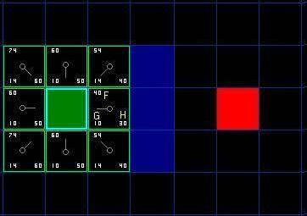
Pathfinding …
The f, g, and h scores are written in each square. f is printed in the top left, g is printed in the bottom left, and h is printed in the bottom right.

Slide 76
Continuing the Search
Simply choose the lowest f score square from all those that are on the open list. We then do the following with the selected square:
1) Drop it from the open list and add it to the closed list.
2) Check all of the adjacent squares. Ignoring those that are on the closed list or unwalkable (terrain with walls, water, or other illegal terrain), add squares to the open list if they are not on the open list already. Make the selected square the “parent” of the new squares.
3) If an adjacent square is already on the open list, check to see if this path to that square is a better one. In other words, check to see if the g score for that square is lower if we use the current square to get there. If not, don’t do anything.

Slide 77
Continuing the Search …
On the other hand, if the g cost of the new path is lower, change the parent of the adjacent square to the selected square (in the diagram above, change the direction of the pointer to point at the selected square).
Finally, recalculate both the f and g scores of that square. If this seems confusing, you will see it illustrated below.

Slide 78
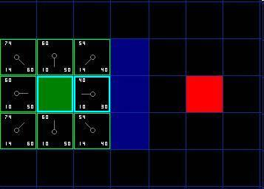
Continuing the Search …
Of our initial 9 squares, we have 8 left on the open list after the starting square was switched to the closed list. Of these, the one with the lowest f cost is the one to the immediate right of the starting square, with an f score of 40. So we select this square as our next square.

Slide 79
Continuing the Search …
Then, we drop it from our open list and add it to our closed list. Then we check the adjacent squares. Well, the ones to the immediate right of this square are wall squares, so we ignore those. The one to the immediate left is the starting square. That’s on the closed list, so we ignore that, too.

Slide 80
Continuing the Search …
When we repeat this process for all 4 of the adjacent squares already on the open list, we find that none of the paths are improved by going through the current square, so we don’t change anything.
So now that we looked at all of the adjacent squares, we are done with this square, and ready to move to the next square.

Slide 81
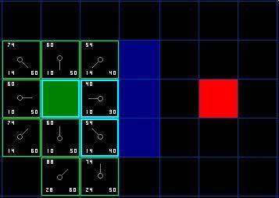
Continuing the Search …
Pathfinding

Slide 82
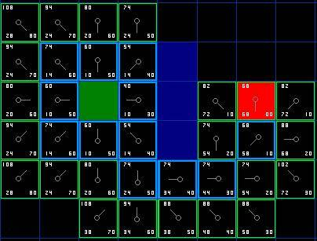
Continuing the Search …
Pathfinding

Slide 83
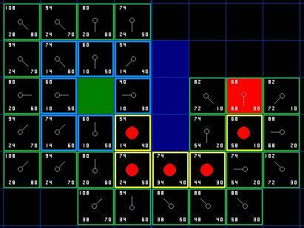
Continuing the Search …
Pathfinding

Slide 84
A* pathfinding summary
1) Add the starting square (or node) to the open list.
2) Repeat the following:
a) Look for the lowest F cost square on the open list. We refer to this as the current square.
b) Switch it to the closed list.
c) For each of the 8 squares adjacent to this current square …
If it is not walkable or if it is on the closed list, ignore it. Otherwise do the following.
- If it isn’t on the open list, add it to the open list. Make the current square the parent of this square. Record the f, g, and h costs of the square.

Slide 85
A* pathfinding summary …
- If it is on the open list already, check to see if this path to that square is better, using g cost as the measure. A lower g cost means that this is a better path. If so, change the parent of the square to the current square, and recalculate the g and f scores of the square. If you are keeping your open list sorted by f score, you may need to resort the list to account for the change.
d) Stop when you:
-- Add the target square to the closed list, in which case the path has been found (see note below), or
-- Fail to find the target square, and the open list is empty. In this case, there is no path.
3) Save the path. Working backwards from the target square, go from each square to its parent square until you reach the starting square. That is your path.

Slide 86
Heuristic Searches
IDA* Search
Problem with A* search
  You have to record all the nodes
  In case you have to back up from a dead-end
A* searches often run out of memory, not time
Use the same iterative deepening trick as IDS
But this time, don’t use depth (path length)
  Use f(n) [A* measure] to define contours
  Iterate using the contours

Slide 87
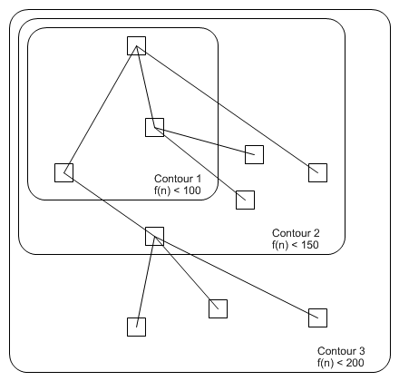
IDA* Search - Contours
Find all nodes
  Where f(n) < 100
  Don’t expand any
    Where f(n) > 100
Find all nodes
  Where f(n) < 200
  Don’t expand any
    Where f(n) > 200
And so on…

Slide 88
Iterative Deepening A* (IDA*)
Idea: Reduce memory requirement of A* by applying cutoff on values of f
Consistent heuristic function h
Algorithm IDA*:
  Initialize cutoff to f(initial-node)
  Repeat:
    Perform depth-first search by expanding all nodes N such that f(N) ≤ cutoff
    Reset cutoff to smallest value f of non-expanded (leaf) nodes

Slide 89
8-Puzzle
4
Cutoff=4
6

Slide 90
8-Puzzle
4
Cutoff=4
4
6
6

Slide 91
8-Puzzle
4
Cutoff=4
4
5
6
6

Slide 92
8-Puzzle
5
4
Cutoff=4
4
5
6
6

Slide 93
8-Puzzle
6
5
4
Cutoff=4
4
5
6
6

Slide 94
8-Puzzle
4
Cutoff=5
6

Slide 95
8-Puzzle
4
Cutoff=5
4
6
6

Slide 96
8-Puzzle
4
Cutoff=5
4
5
6
6

Slide 97
8-Puzzle
4
Cutoff=5
4
5
7
6
6

Slide 98
8-Puzzle
4
5
Cutoff=5
4
5
7
6
6

Slide 99
8-Puzzle
4
5
5
Cutoff=5
4
5
7
6
6

Slide 100
8-Puzzle
4
5
5
Cutoff=5
4
5
5
7
6
6

Slide 101
Advantages/Drawbacks of IDA*
Advantages:
  Still complete and optimal
  Requires less memory than A*
  Avoid the overhead to sort the fringe
Drawbacks:
  Can’t avoid revisiting states not on the current path
  Available memory is poorly used
  (→ memory-bounded search, see R&N p. 101-104)

Slide 102
Heuristic Searches
Hill Climbing (aka Gradient Descent)
Special type of problem:
  Don’t care how we got there
  Only the artefact resulting is interesting
Technique
  Specify an evaluation function, e
    How close a state is to the solution
  Randomly choose a state
  Only choose actions which improve e
  If cannot improve e, then perform a random restart
    Choose another random state to restart the search from
Advantage
  Only ever have to store one state (the present one)
    Cycles must mean that e decreases, which can’t happen

Slide 103
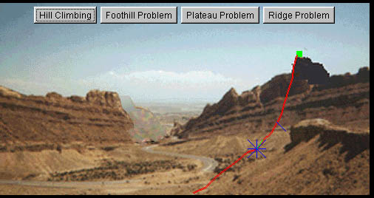
Hill Climbing …

Slide 104
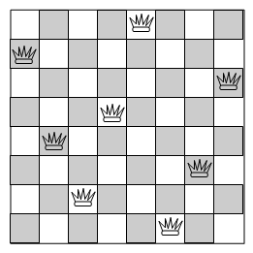
Example – 8 queens problem
Place 8 queens on board
  No one can “take” another
Hill Climbing:
  Throw queens on randomly
  Evaluation
    How many pairs attack each other
  Move a queen out of other’s way
    Improves the evaluation function
  If this can’t be done
    Throw queens on randomly again

Slide 105
Hill Climbing …
Mathematical Description
Hill climbing attempts to maximize (or minimize) a function f(x), where x are discrete states. These states are typically represented by vertices in a graph, where edges in the graph encode nearness or similarity of a graph.
Hill climbing will follow the graph from vertex to vertex, always locally increasing (or decreasing) the value of f, until a local maximum (or local minimum) xm is reached.
Hill climbing can also operate on a continuous space: in that case, the algorithm is called gradient ascent (or gradient descent if the function is minimized).

Slide 106
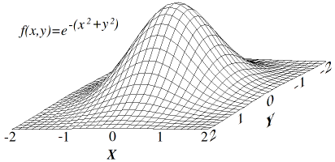
Hill Climbing …
A function f(x,y)

Slide 107
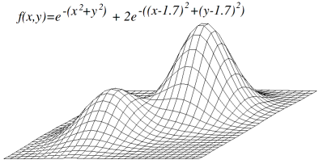
Hill Climbing …
Another function f(x,y)

Slide 108
Hill Climbing …
Hill Climbing Algorithm
  currentNode = startNode;
  loop do
    L = NEIGHBORS(currentNode);
    nextEval = -INF;
    nextNode = NULL;
    for all x in L
      if (EVAL(x) > nextEval)
        nextNode = x;
        nextEval = EVAL(x);
      if nextEval <= EVAL(currentNode)
      //Return current node since no better neighbors exist
        return currentNode;
      currentNode = nextNode;

Slide 109
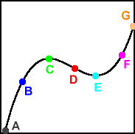
Heuristic Searches:
Simulated Annealing
Problem with hill climbing/gradient descent
  Local maxima/minima
    C is local maximum, G is global maximum
    E is local minima, A is global minimum
  Search must go wrong way to proceed
Simulated Annealing
  Search agent considers a random action
  If action improves evaluation function, then go with it
  If not, then determine a probability based on how bad it is
    Choose the move with this probability
    Effectively rules out really bad moves

Slide 110
Simulated Annealing …
Simulated annealing (SA) is a generic probabilistic meta-algorithm for the global optimization problem, namely locating a good approximation to the global optimum of a given function in a large search space.
It is often used when the search space is discrete (e.g., all tours that visit a given set of cities).
In favorable cases, simulated annealing may be more effective than exhaustive enumeration of the search space.

Slide 111
Simulated Annealing …
The name and inspiration come from annealing in metallurgy, a technique involving heating and controlled cooling of a material to increase the size of its crystals and reduce their defects.
The heat causes the atoms to become unstuck from their initial positions (a local minimum of the internal energy) and wander randomly through states of higher energy; the slow cooling gives them more chances of finding configurations with lower internal energy than the initial one.

Slide 112
Simulated Annealing Algorithm
Minh Pham’s M.S. Thesis: multispectral and texture image classification with intelligent optimization techniques for clustering, CSE, SPSU, 2006
A technique based on the process of annealing metal or crystal.
High temperature which decrease slowly allows the metal or crystal to “work themselves out'' to better ones.
The energy function to control the search is given by Boltzmann:
  P(δE) = exp(-δE /kT)
k: is a constant known as the Boltzmann’s constant, and δE: is the change in energy.
(3)

Slide 113
Simulated Annealing Algorithm (cont.)
Step 1. Start with an initial temperature T₀ and a candidate.
Step 2. Evaluate this candidate and label it as the current one.
Step 3. Generate a new trial candidate and evaluate it.
Step 4. If this trial candidate is better than the current one, accept this as a current candidate and discard the previous one.
Step 5. If this trial is not better than the current one, consider the energy function. Accept this candidate if the probability of the energy function is greater than the random probability.
Step 6. Reduce the temperature and repeat step from step 3 to 5 until the temperature is equal to zero.

Slide 114
Comparing Heuristic Searches
Effective branching rate – one way to characterize the quality of a heuristic
  Idea: compare to a uniform search, U
    Where each node has same number of edges from it
    e.g., Breadth first search
Suppose a search, S, has expanded N nodes
  In finding the solution at depth D
  What would be the branching rate of U (call it b*)
  Use this formula to calculate it:
    N = 1 + b* + (b*)² + (b*)³ + … + (b*)^{D}
  One heuristic function, h, dominates another h’
    If b* is always smaller for h than for h’

Slide 115
Example: Effective Branching Rate
Suppose a search has taken 52 nodes
  And found a solution at depth 5
52 = 1 + b* + (b*)² + … + (b*)⁵
So, using the mathematical equality from notes
  We can calculate that b* = 1.91
If instead, the agent
  Had a uniform breadth first search
  It would branch 1.91 times from each node

Slide 116
Summary
  Initial state, operators, goal test, state space, BFS, Uniform-cost search,
  DFS, Depth-limited search,
  Iterative deepening search, bidirectional search,
  A*, Hill-climbing,
  simulated annealing, greedy search
  Beam search
  Bidirectional search
  Tabu Search
  Genetic Algorithm Search

Slide 117


Questions & Suggestions?
The End

